Slide 1
David Wilson – Microsoft Research Uri Zwick – Tel Aviv Univ.
A Forward-Backward Single-Source Shortest Paths Algorithm
“Single-Source Shortest Paths in O(n) time”
Deuxièmes journées du GT CoA Complexité et Algorithmes
19-20 novembre Université Paris Diderot (LIAFA)
TexPoint fonts used in EMF.
Read the TexPoint manual before you delete this box.: AAAAAA

Slide 2
Single-Source Shortest Paths in weighted directed graphs with non-negative edge weights
Worst case result
Dijkstra (1959) | m + n log n
Arbitrary graph, random U[0,1] edge weights
Meyer (2003) Goldberg (2008) Hagerup (2006) | m + n

Slide 3
All-Pairs Shortest Paths in weighted directed graphs
Worst case results
n × Dijkstra | mn + n² log n
Pettie (2004) | mn + n² log log n
Chan (2007) | ≈ n³ / log²n

Slide 4
All-Pairs Shortest Paths in randomly weighted complete directed graphs
Expected running times (some with high probability)
Spira (1973) | n² log²n
Bloniarz (1983) | n² log n log*n
Moffat-Takaoka (1987) Mehlhorn-Priebe (1997) | n² log n
Demetrescu-Italiano (2004)
Peres-Sotnikov- Sudakov-Z (2010) | n²
First three results hold in the endpoint independent model

Slide 5
Single-Source Shortest Paths in randomly weighted complete directed graphs with sorted adjacency lists
Using only out-going adjacency lists
Spira (1973) | O(n log²n)
Bloniarz (1983) | O(n log n log*n)
Moffat-Takaoka (1987) Mehlhorn-Priebe (1997) | O(n log n)
Using both out-going and in-coming adjacency lists
Mehlhorn-Priebe (1997) | Ω(n log n)
Wilson-Z (2013) | O(n)

Slide 6
Endpoint independent model [Spira (1973)]
For each vertex v use an arbitrary process to generate n−1 edge weights
Randomly permute the n−1 edge weights and assign them to the out-going edges of v

Slide 7
Dijkstra’s algorithm
Priority-queue holds vertices
When a vertex is “settled”, relax all its out-going edges

Slide 8
Spira’s algorithm [Spira (1973)]
Lazy version of Dijkstra’s algorithm
Uses sorted out-going adjacency lists
Edges are examined one at a time
current edge

Slide 9
Spira’s algorithm [Spira (1973)]
Priority-queue holds current edges
After extracting an edge, examine the next out-going edge
Fewer edges examined
More extractions from priority queue

Slide 11
Analysis of Spira’s algorithm in the endpoint independent model
Suppose that k vertices were found
Each edge extracted from PQ has prob. > (n−k)/n of leading to a new vertex
Sub-linear algorithm
Can it be further improved?

Slide 12
Verification of Shortest Paths Trees
Is this a SPT?

Slide 13
Verification of Shortest Paths Trees
Is this a SPT?

Slide 14
Could in-coming adjacency lists help?

Slide 15
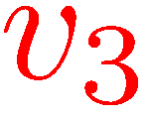
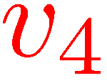
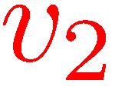
Distances in a complete graph with independent EXP(1) edge weights [Davis-Prieditis (1993)] [Janson (1999)]

Slide 16
Distances in a complete graph with independent EXP(1) edge weights [Davis-Prieditis (1993)] [Janson (1999)]

Slide 17
Distances in a complete graph with independent EXP(1) edge weights [Janson (1999)]

Slide 18
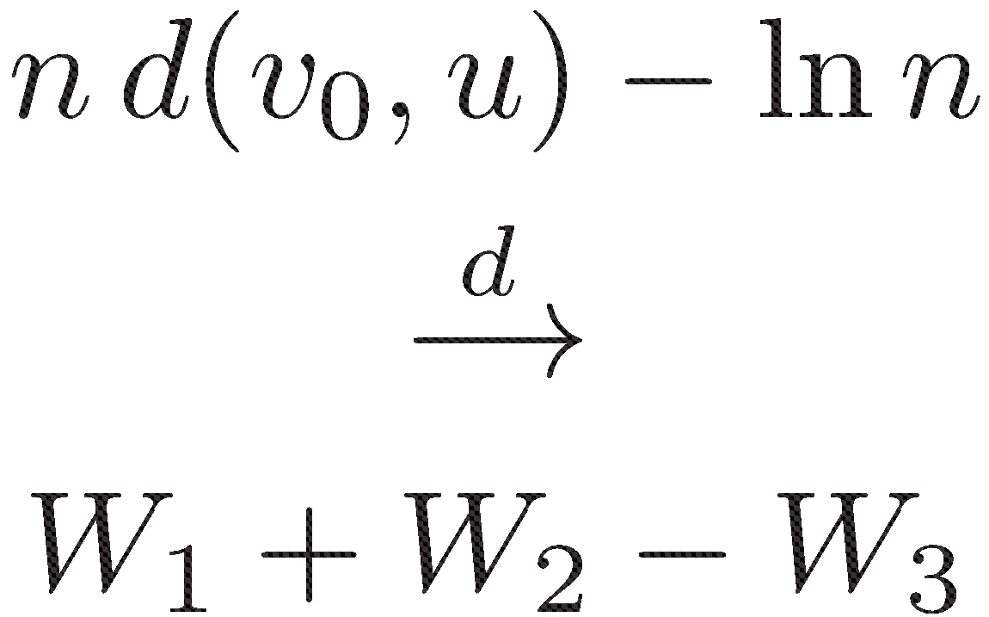

Slide 19
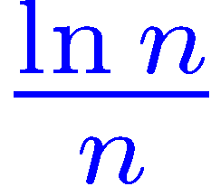
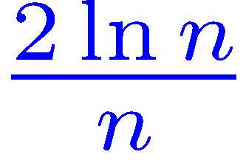
Forward-only verification

Slide 20
Pertinent edges
out-pertinent edges
in-pertinent edges

Slide 21
Forward-backward verification
Check only pertinent edges!
!

Slide 22
Number of pertinent edges
Expected number of pertinent edges is Θ(n)
Probability that number of pertinent edges is more than Θ(n) is exponentially small

Slide 23
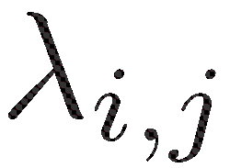
Number of pertinent edges
Condition on a SPT and distances

Slide 24
Number of out-pertinent edges
Comparison with a Poisson process

Slide 25
Forward-backward SSSP algorithm
Goal: Run Spira’s algorithm on the subgraph composed of pertinent edges
Run Spira’s algorithm until median distance M is found
Out-pertinent edges are easy to identify
How do we identify the in-pertinent edges?
Backward scans used to identify in-pertinent edges
When an in-pertinent edge is found, a request is issued for its forward scan

Slide 26
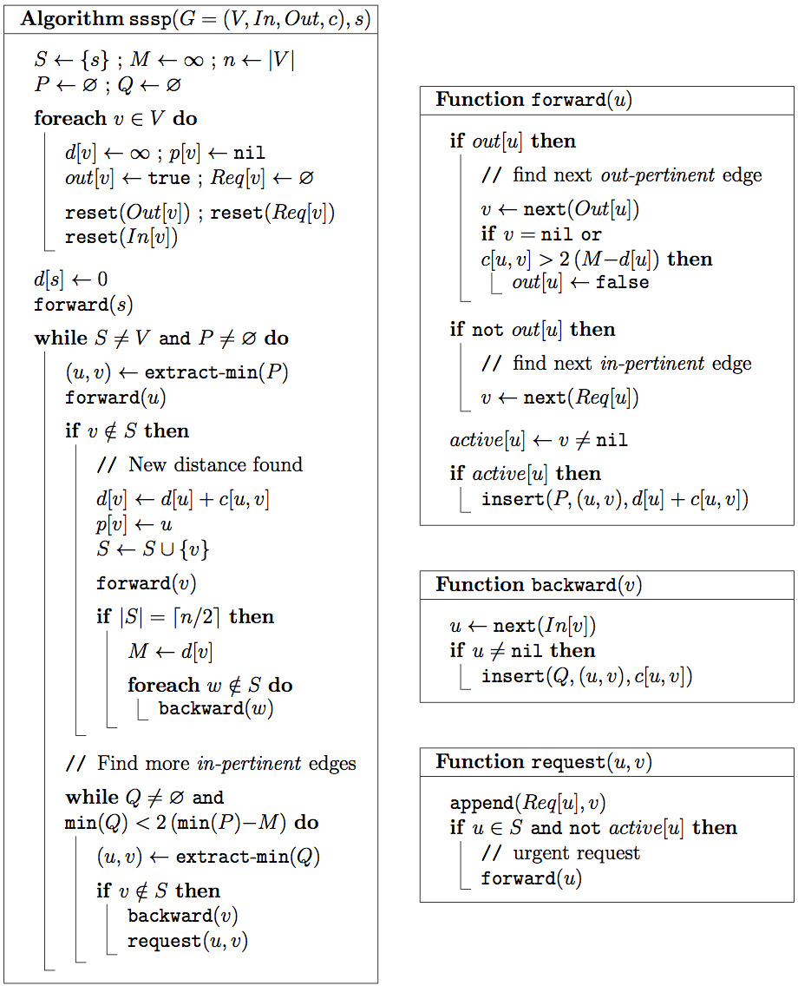

Slide 27
Adjacency lists
out-pertinent
in-pertinent
Out[u]
v
in-pertinent
Req[u]
v
in-pertinent
In[v]
u

Slide 28
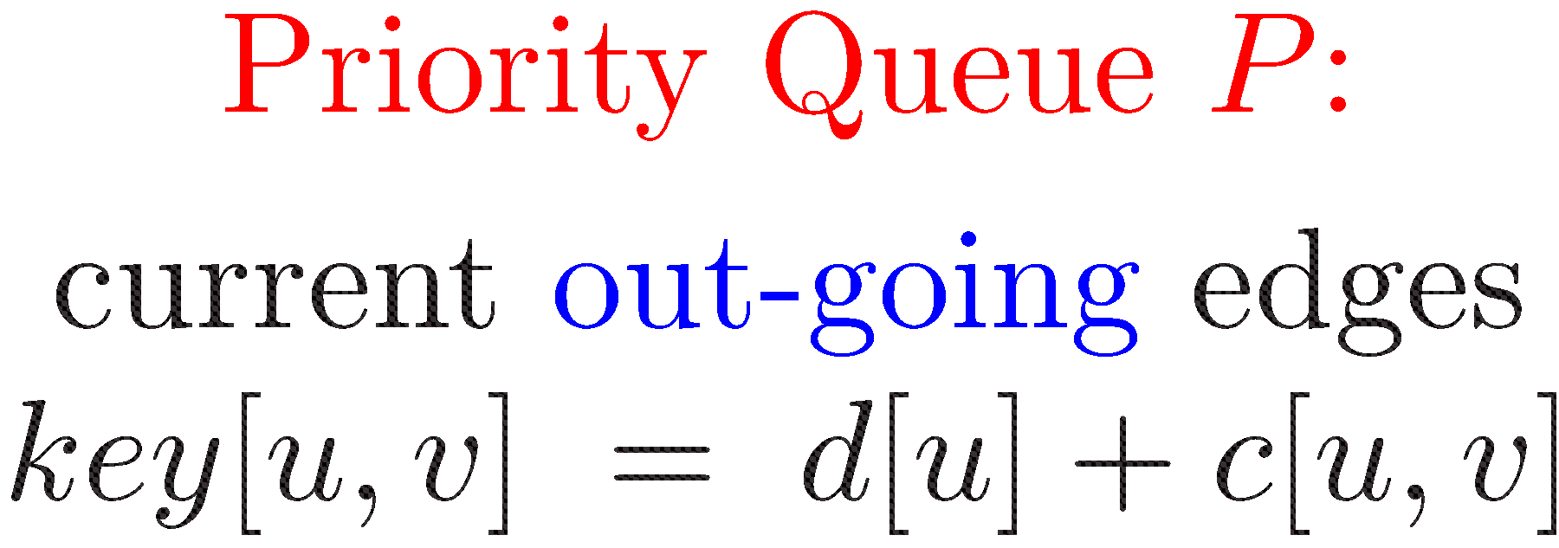
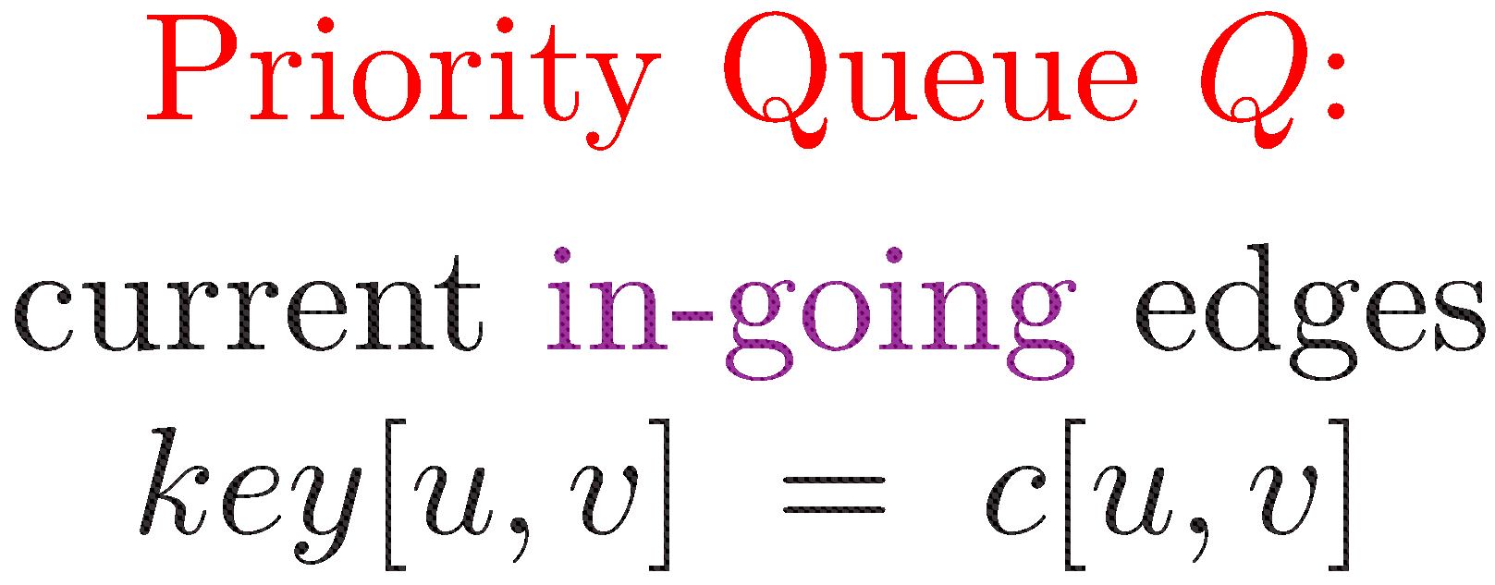
Identifying in-pertinent edges

Slide 29
( (u,v) is an in-pertinent edge )
Append (u,v) to Req[u]
If u has no current edge, the request is urgent,
and (u,v) is immediately inserted into P

Slide 30
Identifying in-pertinent edges

Slide 31
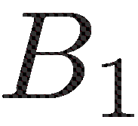
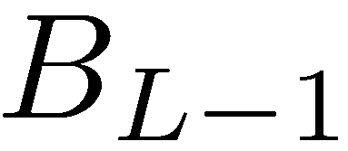
Bucket-based priority queues
…

Slide 32
Two-level Bucket-based priority queues
If a bucket contains k items when it becomes active, split it into k sub-buckets
Store the items in each sub-bucket in a binary heap
Probability of more than Θ(n) time is

Slide 33
Open problems
More edge weight distributions? (We already have some extensions)
n+o(m) for arbitrary graphs with random edge weights?
End-point independent model?
Could the new forward-backward algorithm be useful in practical applications?

